Slide 1
Home Credit Default Risk-A Comparative Analysis of ML Models
Srinath Bulusu-1002197525
Pranay Mohan Kanakabandi -1002198613
Manas Pavan Sai Kallaganti - 1002209866
Sai Prabhakar Gattu - 1002209363

Slide 2
Introduction
Home Credit aims to provide financial inclusion to individuals who lack access to traditional credit by using alternative data sources such as telco and transaction history to assess borrowers' ability to repay loans. Accurate predictions of loan defaults are critical to ensuring that creditworthy individuals are not rejected and that loans are structured to avoid over-indebtedness.

Slide 3
OVERVIEW OF KAGGLE PAPER
The Kaggle competition "Home Credit Default Risk" aimed to enhance financial inclusion by predicting the repayment capabilities of clients with limited credit histories. Participants were provided with a comprehensive dataset containing various features, including demographic information, financial data, and behavioral indicators, to develop models that assess the likelihood of loan defaults.
Key Aspects of the Competition:
Objective: Develop machine learning models to predict the probability of a client defaulting on a loan, thereby assisting Home Credit in making informed lending decisions.
Data Provided: The dataset included multiple tables with information such as application data, previous credit records, and payment histories. This allowed participants to perform extensive feature engineering and data analysis.
Evaluation Metric: Submissions were evaluated based on the area under the Receiver Operating Characteristic curve (AUC-ROC), which measures the model's ability to distinguish between defaulters and non-defaulters.
Feature Importance Results:
It was analysed to understand which variables had the greatest influence on predicting loan defaults. The top features included:
Debt-to-Income Ratio: Indicates financial stress and is highly predictive of loan default.
Number of Previous Loans: A higher number of past loans correlated with an increased likelihood of default.
Mobile Payment Behavior: Telco data provided insight into applicants' non-traditional financial behaviour, which was also an important predictor.

Slide 4
Goal: Assess applicants’ repayment ability using machine learning to enhance financial inclusion.
Problem Statement: Many individuals lack traditional credit history, necessitating alternative methods for risk evaluation.
Models Evaluated: Random Forest, Logistic Regression, K-Nearest Neighbors (KNN), and Linear Support Vector Machine (SVM),Neural Networks.
Source: https://www.kaggle.com/competitions/home-credit-default-risk/overview

Slide 5
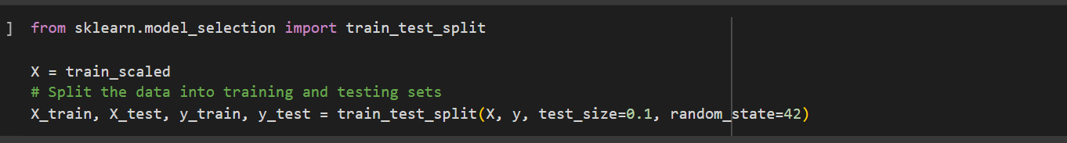
Dataset Description:
121 columns covering applicant demographics, previous loans, telco data, and transaction history.
Data Sources: Application data, previous loan records, telco behavior, and transaction logs.
Preprocessing Steps:
Handling Missing Data: Missing values were imputed using mean values for numerical columns and the mode for categorical columns.
Feature Encoding: Categorical variables were encoded using one-hot encoding to convert them into a suitable format for the machine learning models.
Feature Scaling: Features were standardised (zero mean, unit variance) to ensure equal contribution from all features, especially for models like KNN and SVM, which are sensitive to the scale of the data.
Test and Train Split

Slide 6
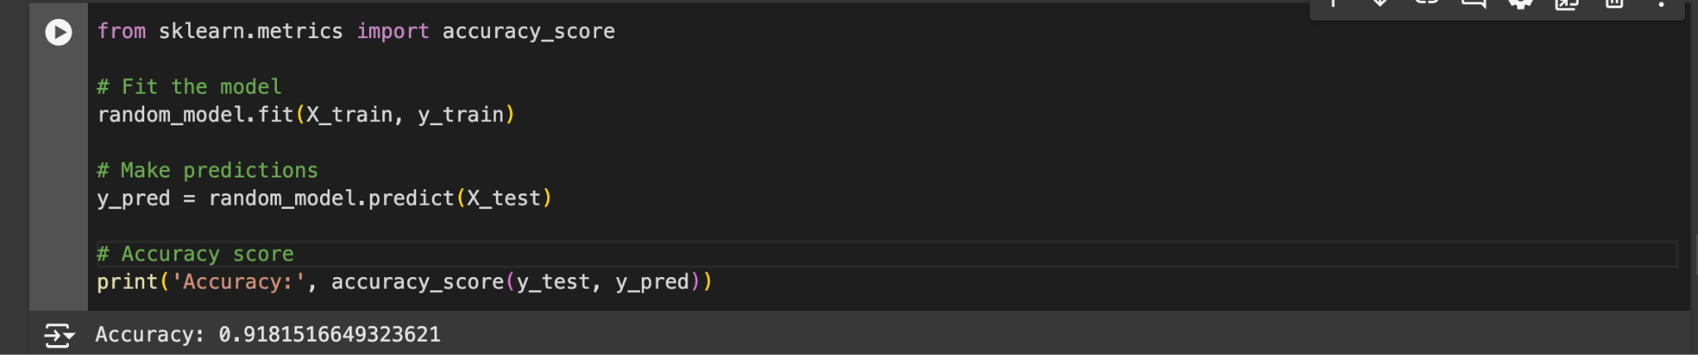
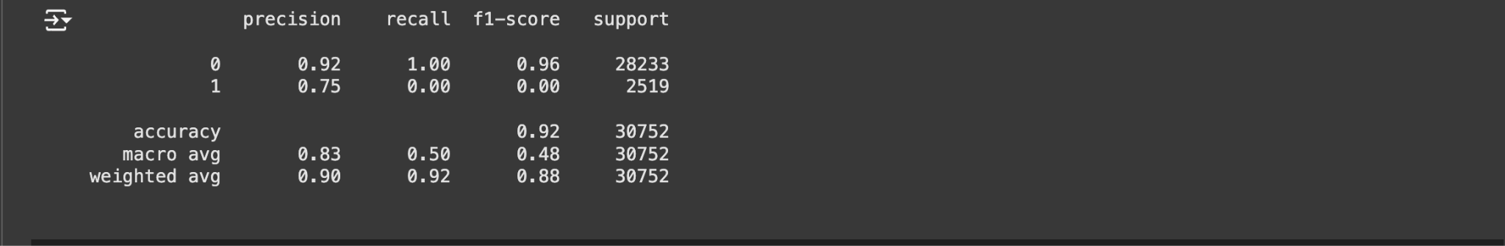
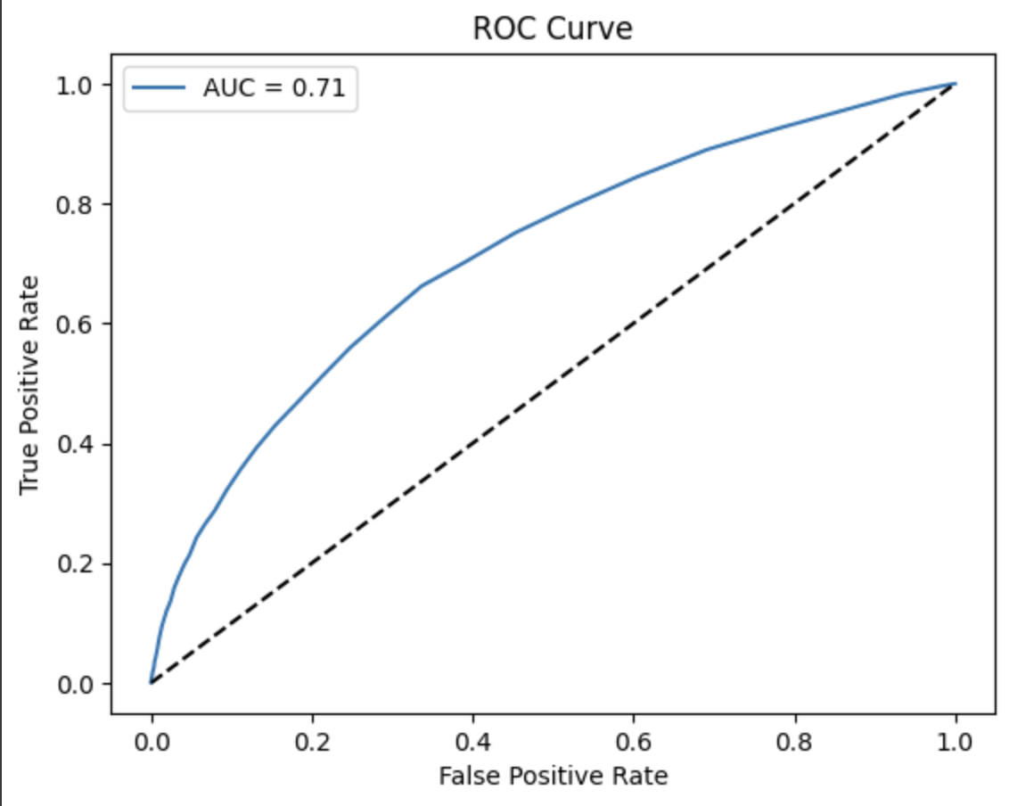
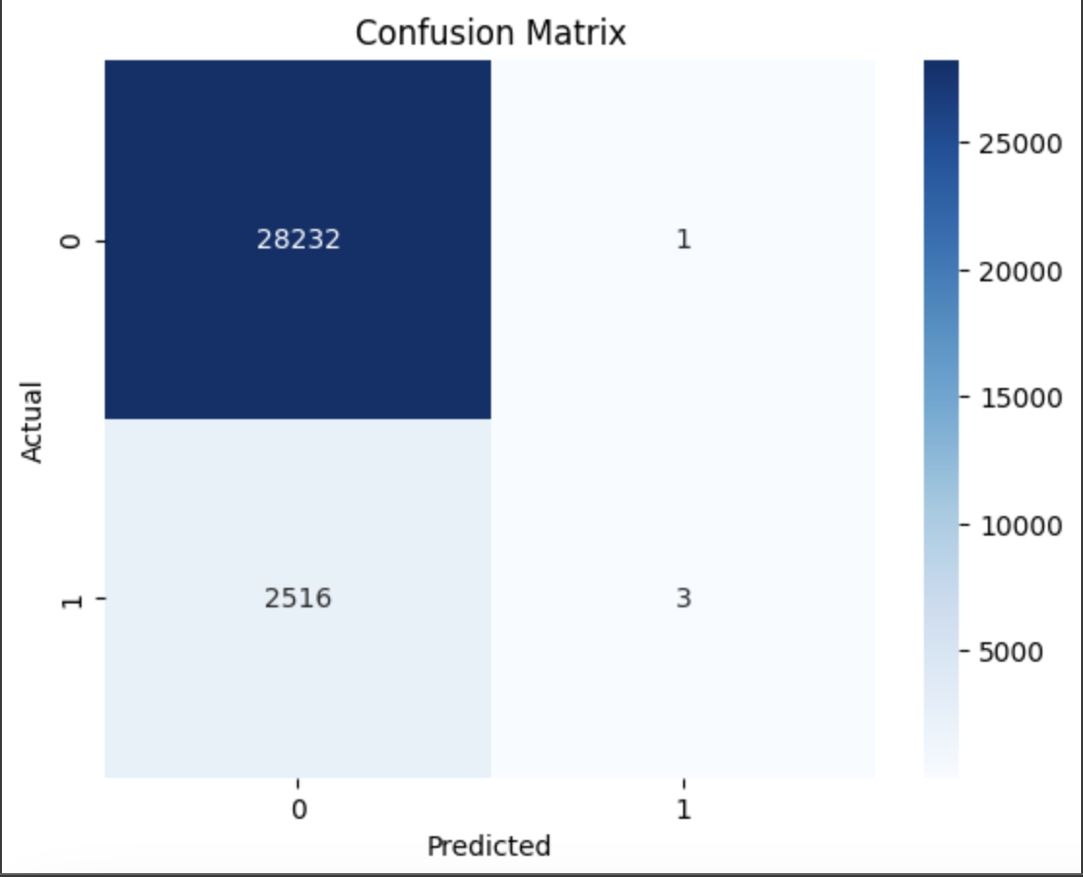
RANDOM FOREST
An ensemble learning method that combines multiple decision trees. Each tree is built using a random subset of features and data, and the final output is based on a majority vote or average prediction.
Why Selected: Random Forest is robust to overfitting and captures non-linear relationships, making it ideal for complex datasets with mixed numerical and categorical data.

Slide 7
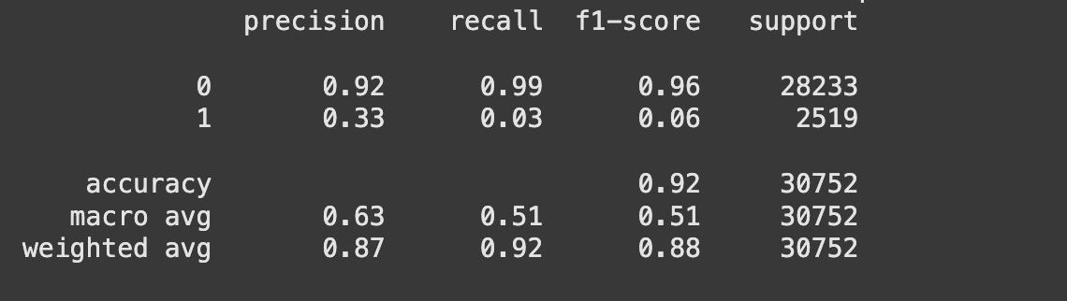
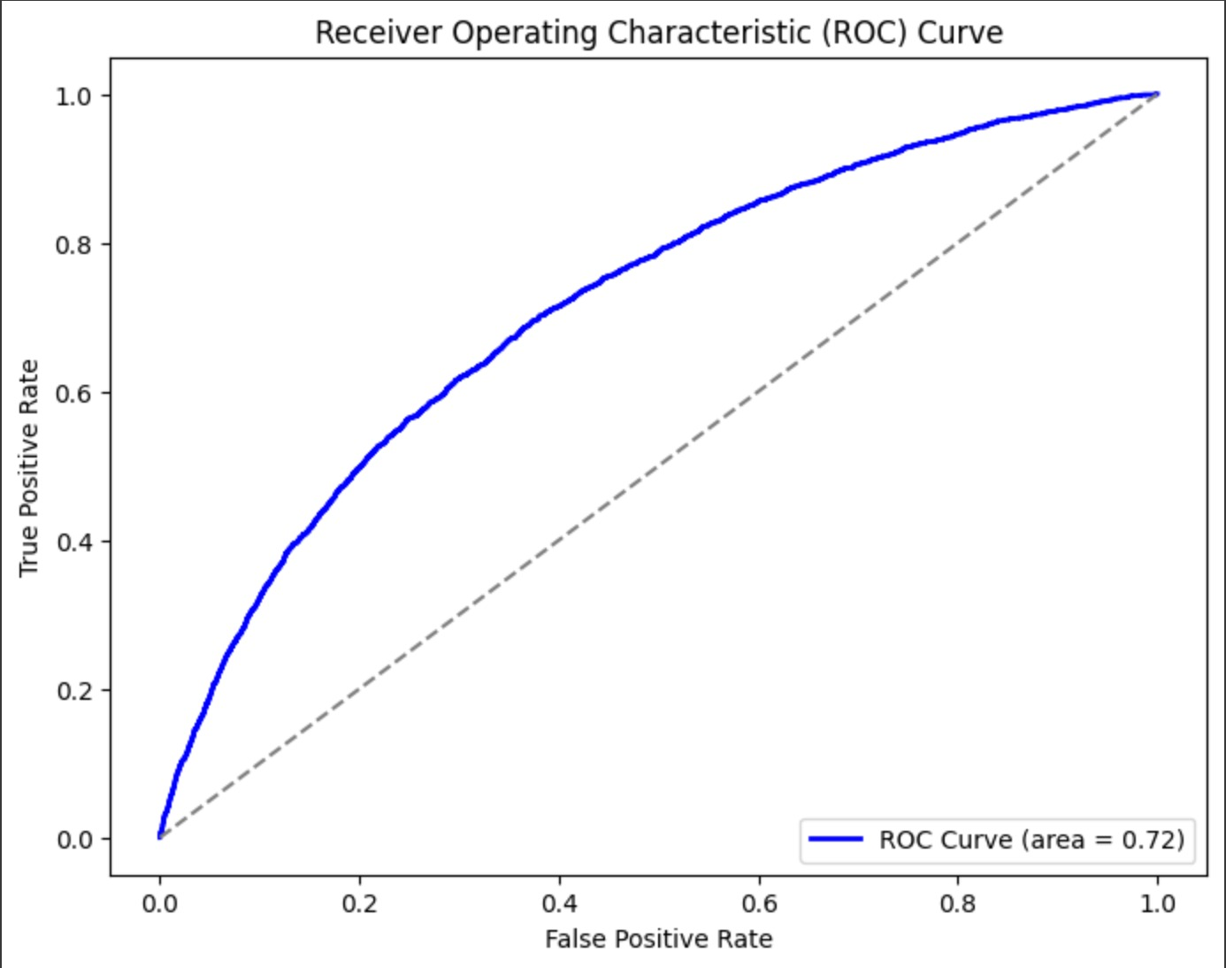

NEURAL NETWORKS
Loan default prediction often involves non-linear relationships between features, such as income, debt-to-income ratio, and payment behavior. Neural networks excel at capturing these relationships because of their layered architecture, which can learn complex patterns automatically.
We have taken 6 fully connected layers (1 input,3 dense layers,batch normalization layer,output layer)
Traditional models like Logistic Regression or even Random Forests might struggle to fully exploit these interactions without extensive feature engineering.

Slide 8
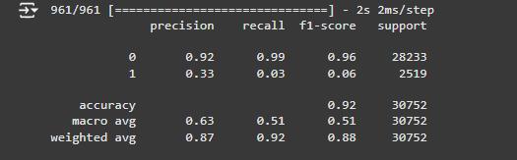
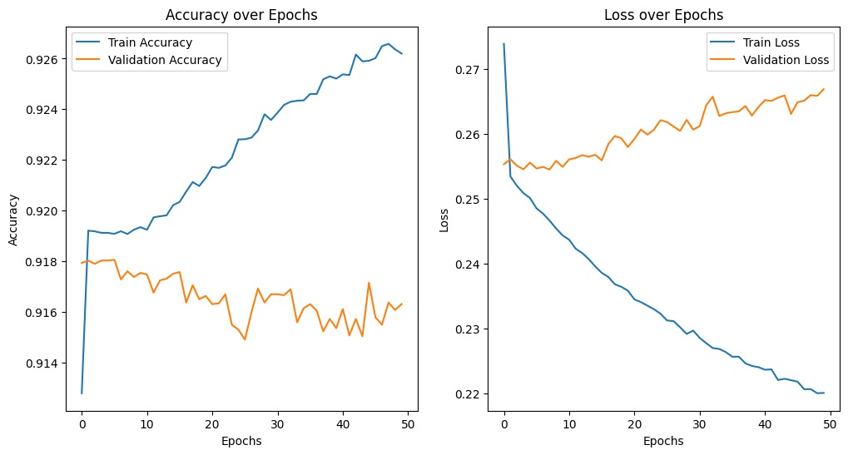

Slide 9
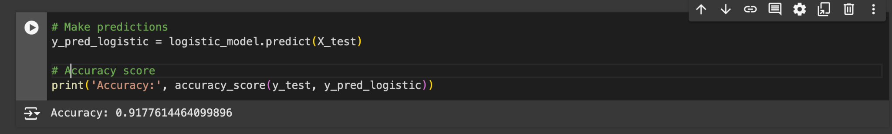
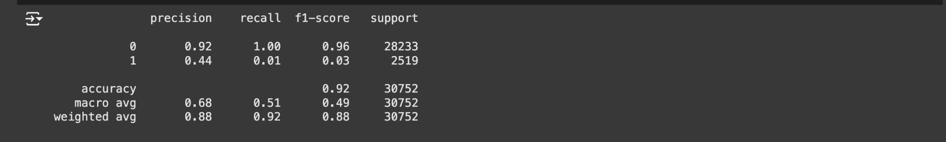
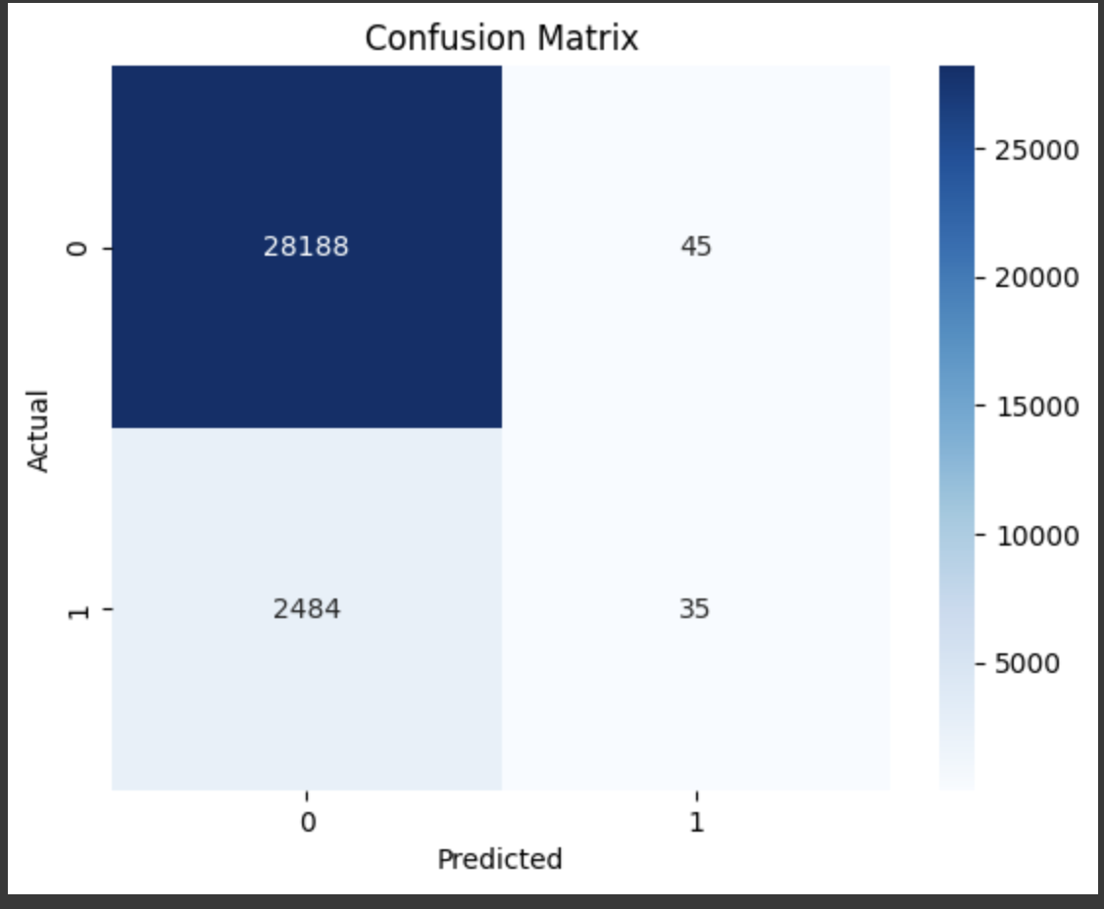
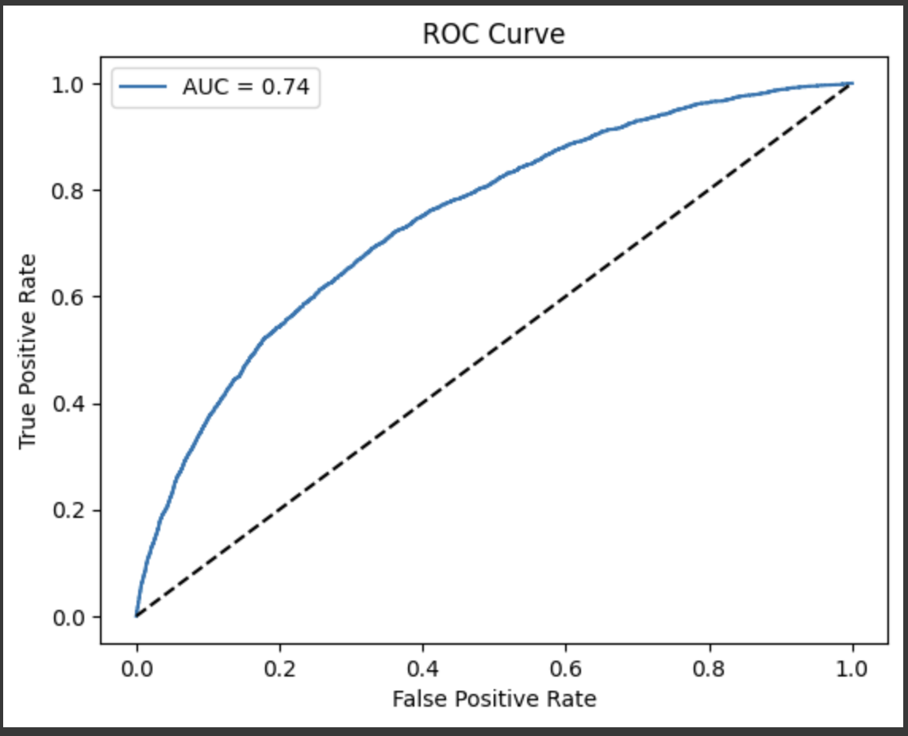
Logistic Regression:
A linear model that predicts probabilities using a sigmoid function. It models the log odds of the target variable as a linear combination of input features.
Why Selected: It is a simple and interpretable model that provides a strong baseline for binary classification problems.

Slide 10
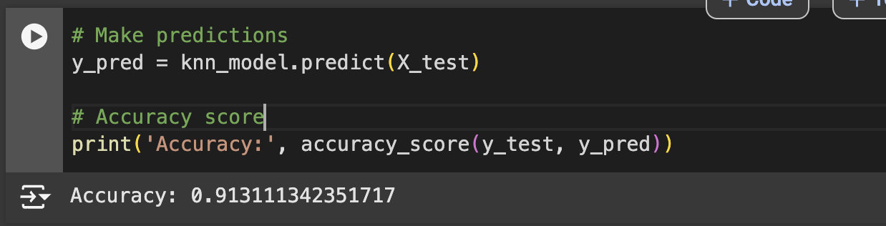
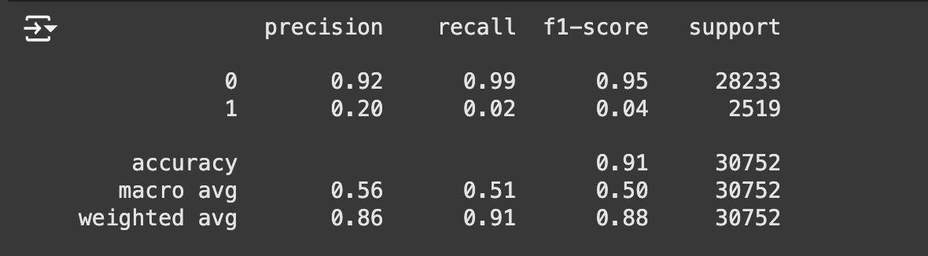
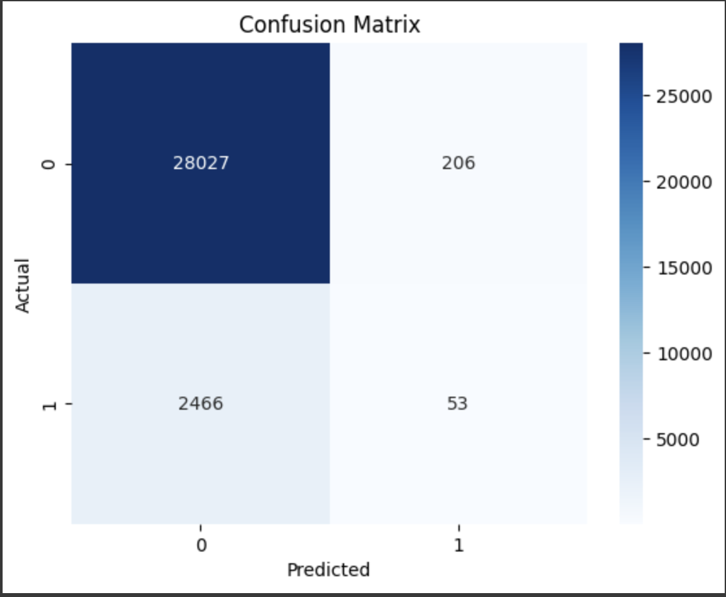
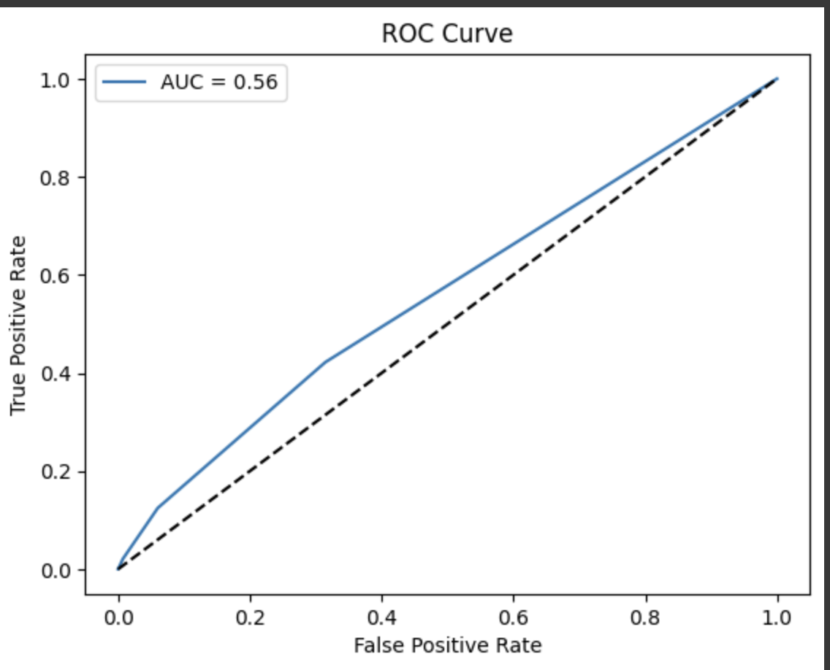
K-Nearest Neighbors (KNN):
A non-parametric model that classifies an instance based on the majority class of its nearest neighbors in the feature space.
Why Selected: KNN is straightforward and effective for datasets where similar observations are expected to share the same outcomes. It tests the value of proximity-based learning.

Slide 11
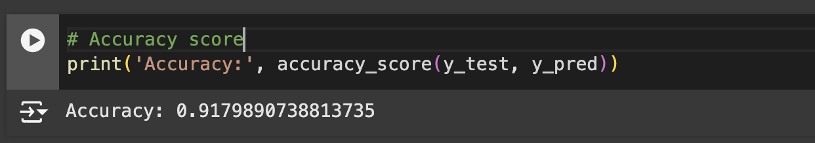
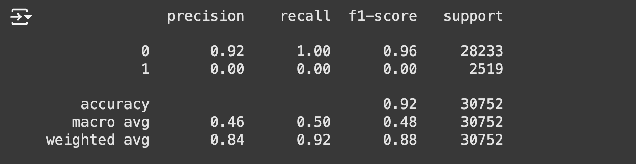

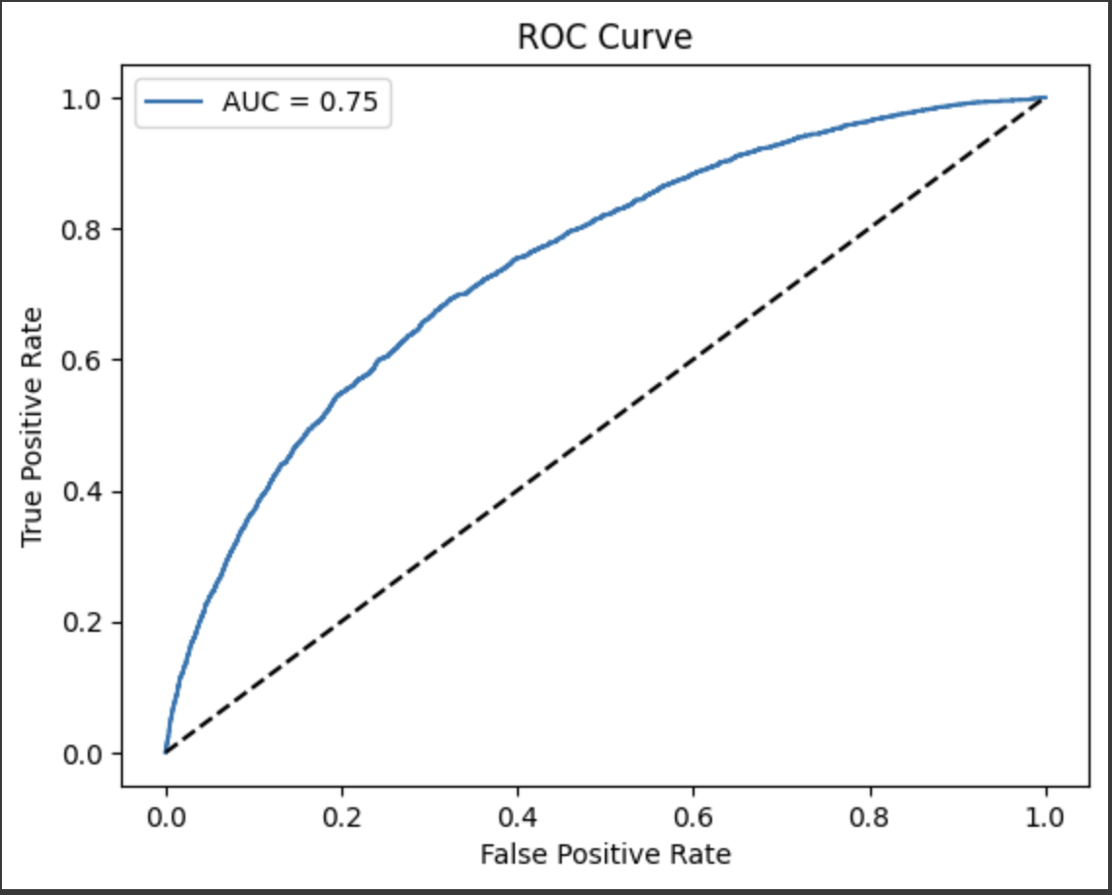
Linear Support Vector Machine (SVM):
Methodology: A linear classifier that finds the hyperplane maximizing the margin between the two classes. It aims to separate the classes with the widest possible boundary.
Why Selected: SVMs are effective for high-dimensional spaces and are less likely to overfit on smaller datasets.

Slide 12
Challenges
Class Imbalance: Most applicants were non-defaulters, creating a skewed dataset that could mislead models.
High Dimensionality: With 121 features, models like KNN struggled due to the ‘curse of dimensionality.’
Feature Selection: Identifying impactful features, such as debt-to-income ratio and payment history, required significant effort.
Solutions:
Oversampling the Minority Class,Undersampling the Majority Class,Stratified Sampling
Use Principal Component Analysis (PCA) to reduce the number of features while preserving variance.
Not all 121 features in the dataset will be equally important for predicting loan defaults. Selecting impactful features reduces
noise, improves interpretability, and enhances model performance.

Slide 13
Results
Our analysis revealed significant differences in model performance:
Random Forest: Achieved the highest precision and recall.
Neural Network: Achieved the highest accuracy and recall, making it the best performer overall.
Logistic Regression: A strong baseline model with competitive results in most metrics.
KNN: Struggled due to high dimensionality, reflected in its low AUC-ROC.
Linear SVM: Achieved good recall but lower AUC-ROC compared to Random Forest.
Model | Accuracy | Precision | Recall | F1-Score | AUC-ROC
Random Forest | 0.91815 | 0.90 | 0.92 | 0.88 | 0.71
Neural Networks | 0.92 | 0.87 | 0.92 | 0.88 | 0.72
Logistic Regression | 0.91776 | 0.88 | 0.92 | 0.88 | 0.74
K-Nearest Neighbors | 0.91311 | 0.86 | 0.91 | 0.88 | 0.56
Linear SVM | 0.91798 | 0.84 | 0.92 | 0.88 | 0.75

Slide 14
Observations
Random Forest is the best model, offering robust performance across all metrics.
Neural Netwoks offer better accuracy and recall but has less precision
Logistic Regression is a close competitor and remains an interpretable alternative.
KNN and Linear SVM are less effective in handling this dataset’s complexity and high dimensionality.
Future work could include exploring advanced models like XGBoost or incorporating external data to improve predictive power.
1. ROC Curve and AUC (Area Under the Curve)
Importance:
ROC Curve shows the trade-off between True Positive Rate (Recall) and False Positive Rate as the decision threshold varies.
AUC summarizes the ROC Curve into a single value between 0 and 1. A higher AUC indicates better discrimination between classes.
Particularly important for imbalanced datasets, as it is not affected by the actual class distribution.
Prefer models with a higher AUC as they indicate better separability between classes.

Slide 15
3. Accuracy
Importance:
Indicates the proportion of correctly classified instances over the total dataset.
When to Prioritize:
Only when the dataset is balanced (similar number of defaulters and non-defaulters).
Model Selection:
Avoid relying solely on accuracy for imbalanced datasets, as it can be misleading. For example, predicting all applicants as non-defaulters in an imbalanced dataset could still yield high accuracy.
2. Confusion Matrix
Importance:
Gives a granular view of model predictions:
True Positives (TP): Correctly identified defaulters.
True Negatives (TN): Correctly identified non-defaulters.
False Positives (FP): Non-defaulters incorrectly classified as defaulters.
False Negatives (FN): Defaulters missed by the model.
3. Accuracy
Importance:Indicates the proportion of correctly classified instances over the total dataset.
When to Prioritize:
Only when the dataset is balanced (similar number of defaulters and non-defaulters).
Model Selection:Avoid relying solely on accuracy for imbalanced datasets, as it can be misleading. For example, predicting all applicants as non-defaulters in an imbalanced dataset could still yield high accuracy.
4. Precision
Importance:Measures the proportion of positive predictions (defaulters) that are actually correct.
When to Prioritize:
When False Positives are costly. For example:
A high number of FP (non-defaulters flagged as defaulters) could result in unnecessary loan denials, impacting customer satisfaction and trust.
Model Selection:Choose a model with high precision when avoiding FP is critical.

Slide 16
5. Recall (Sensitivity or True Positive Rate)
Importance:Measures the proportion of actual positives (defaulters) that are correctly identified.
When to Prioritize:When False Negatives are costly. For example:
Missing a defaulter (FN) could lead to financial loss for the lender.
Model Selection:Select a model with high recall when catching all defaulters is more important than occasionally flagging non-defaulters.
6. F1-Score
Importance:Balances precision and recall, providing a single metric for scenarios where both FP and FN are important.
When to Prioritize:For imbalanced datasets where both types of errors need to be considered.
Useful when you need a trade-off between precision and recall.
Model Selection:
Choose a model with the highest F1-Score when balancing FP and FN is crucial.

Slide 17
MODEL SELECTION
Understand Business Priorities:
High recall: If missing defaulters is more costly.
From the results we can see the false negetive rate affects the
Business which means many defaulters are missed
Result:
Focus on recall (catching all defaulters) and ensure a reasonable AUC.
Logistic Regression satisfies and outperforms Random Forest ,Neural Network in terms of AUC while recall for 3 of them are same
Model | Accuracy | Precision | Recall | F1-Score | AUC-ROC
Random Forest | 0.91815 | 0.90 | 0.92 | 0.88 | 0.71
Neural Network | 0.92 | 0.87 | 0.92 | 0.88 | 0.72
Logistic Regression | 0.91776 | 0.88 | 0.92 | 0.88 | 0.74
K-Nearest Neighbors | 0.91311 | 0.86 | 0.91 | 0.88 | 0.56
Linear SVM | 0.91798 | 0.84 | 0.92 | 0.88 | 0.75

Slide 18
THANK YOU

